Slide 1
AI-Synthesized fake voice detection

Slide 2
Deepsonar approach
DeepSonar approach involves the use of multi layer neural network to convert one dimensional audio signals into n dimensional vector which are then fed into a simple binary classifier network which uses thin-ResNet in backend to classify between real and fake voice signals.

Slide 3
Why deepsonar?
DeepSonar tries to improve upon the shortcomings of bi spectral analysis method to distinguish human voices and AI-Synthesized voices based on the observation of the bi spectral artifacts in fake voices.
Bi spectral analysis suffers from evasions due to the global generalization of its threshold, moreover it is more susceptible to environmental noises.
DeepSonar uses neural network in which each layer has different threshold thus localizing the threshold, which foiled evasions as we knew which layer contributed the most toward audio recognition.

Slide 4
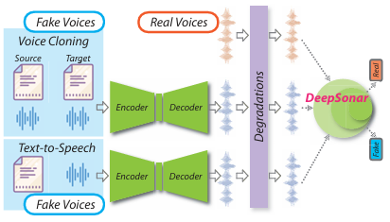
Basic approach
Of DeepSonar

Slide 5
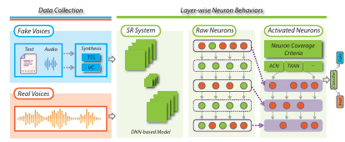
Architecture of DEepsonar

Slide 6
Possible Implementation
Design a shallow neural network with five fully-connected layers as our binary-classifier for discerning fakes. The optimizer is SGD with momentum 0.9 and the starting learning rate is 0.0001, with a decay of 1e-6. The loss function is binary cross-entropy. In monitoring neuron behaviors, we employ a speaker recognition deep network that adopts a ‘thin-ResNet’ as its backend architecture and select the convolutional and fully-connected layers to capture the layer-wise neuron behaviors as input features.

Slide 7
Thank you
Anshika Sharma(57407)
Mithil M Pathak(57436)
Deepti Koranga(57537)
Chandranshu Amola(58005)

